Slide 1
Multi-agent simulation: From air to urban traffic modeling
Michal Pechoucek
Czech Technical University in Prague pechoucek@fel.cvut.cz, www.agents.cz
Notes:
[1] multi-agent systems, ... all the intro
[2] link between research and applications = multi-agent simulation
[3] one concrete example ... NAS traffic
[4] maritime security
[4] mixed mode traffic, simulation and security
--
To do simulation of complex systems, wider integration of data sources

Slide 2
Introduction – what to expect
Fundamental claims in my talk:
We are surrounded by natural multi-agent systems that need sophisticated administration, control and exploitation (good)
Methods of multi-agent research represent suitable means for modeling, observing and controlling natural multi-agent systems (good)
Methods of multi-agent research are difficult to deploy in massive, critical, real-time industrial applications (bad)
Towards a solution:
Multi-agent simulation has got an important potential for facilitating and accelerating the development of multi-agent application used for modeling, observing and running natural multi-agent systems.

Slide 3
Agents briefly (one slide only)
multi-agent system is a decentralized multi-actor (software) system, often geographically distributed whose behavior is defined and implemented by means of complex, peer-to-peer interaction among autonomous, rational and deliberative entities.
autonomous agent is a special kind of a intelligent software program that is capable of highly autonomous rational action, aimed at achieving the private objective of the agent – can exists on its own but often is a component of a multi-agent system – agent is autonomous, reactive, proactive and social
agent technology is software technology supporting the development of the autonomous agents and multi-agent systems agent-based computing is a special research domain, subfield of computer science and artificial intelligence that studies the concepts of autonomous agents
agent researchers study problems of integration, communication, reasoning and knowledge representation, competition (games) and cooperation (robotics), agent oriented software engineering, …

Slide 4
Multi-agent application
Multi-agent application is a software system, functionality of which is given by interaction among autonomous software/hardware/human components.
But also a monolithic software application that is autonomously operating within a community of autonomously acting software applications, hardware systems or human individuals.
Currently, multi-agent simulation – multi-agent software system simulating a behavior of other multi-agent system (SW, HW, human), is used either:
for studying properties of real multiagent systems that can be hardly observed (such as crowd behavior in emergency situation, cancer cells reproduction modeling or ...) or
for testing various multiagent application before they are used in physical systems (such as various robotics and autonomous systems applications, methods for urban traffic control or testing various security applications).

Slide 5
Multi-agent application
Multi-agent application is a software system, functionality of which is given by interaction among autonomous software/hardware/human components. But also a monolithic software application that is autonomously operating within a community of autonomously acting software applications, hardware systems or human individuals.
there are several good examples of this to have happened e.g. LostWax Aeorogility, Glacsweb (Glacier sensor network), FAMS (Federal Air Marshals Services), Rockwell shipboard automation of a chilling system, London taxi scheduling

Slide 6
Multi-agent application
Multi-agent application is a software system, functionality of which is given by interaction among autonomous software/hardware/human components. But also a monolithic software application that is autonomously operating within a community of autonomously acting software applications, hardware systems or human individuals.
Intelligent systems based application still do not fully leverage the potential of the multi-agent technologies due to:
Potential still not believable – lack of case-studies, lack of convincing quantitative argument
Limits on scalability and fidelity – early demos are not believed to scale up to industrial requirements
High costs & high risks – deployment is costy and benefits not certain

Slide 7
Multi-agent simulation
Agent-based computing have been used:
Design paradigm – the concept of decentralized, interacting, socially aware, autonomous entities as underlying software paradigm (often deployed only in parts, where it suits the application)
Source of technologies – algorithms, models, techniques architectures, protocols but also software packages that facilitate development of multi-agent systems
Simulation concept – a specialized software technology that allows simulation of natural multi-agent systems, based on (1) and (2).
We suggest:
using (3) for development the combination of (1) and (2) supporting development of multi-agent applications
Notes:
Perhaps out

Slide 8
General MASim Architecture

Slide 9
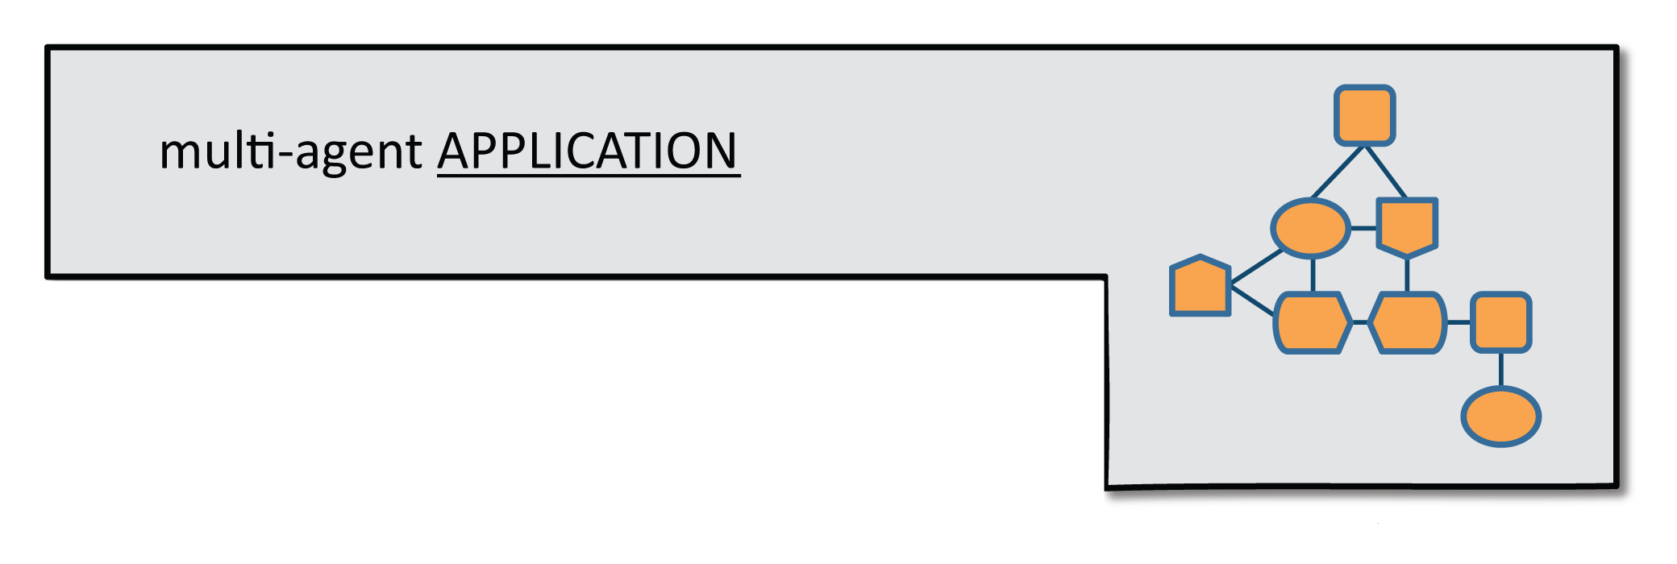
General MASim Architecture

Slide 10
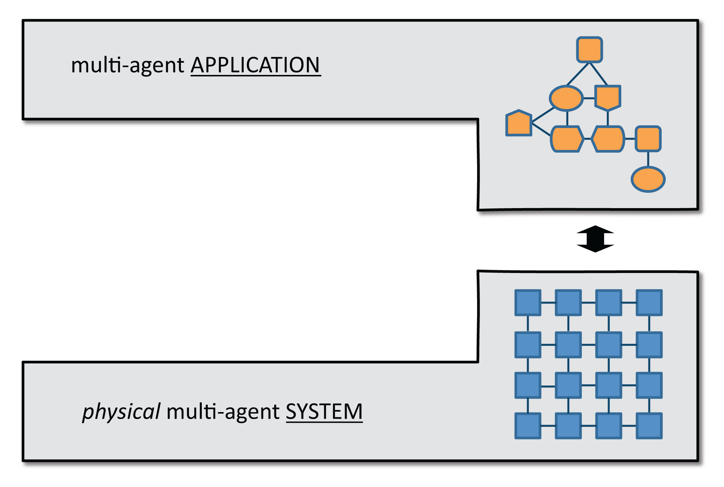
General MASim Architecture

Slide 11
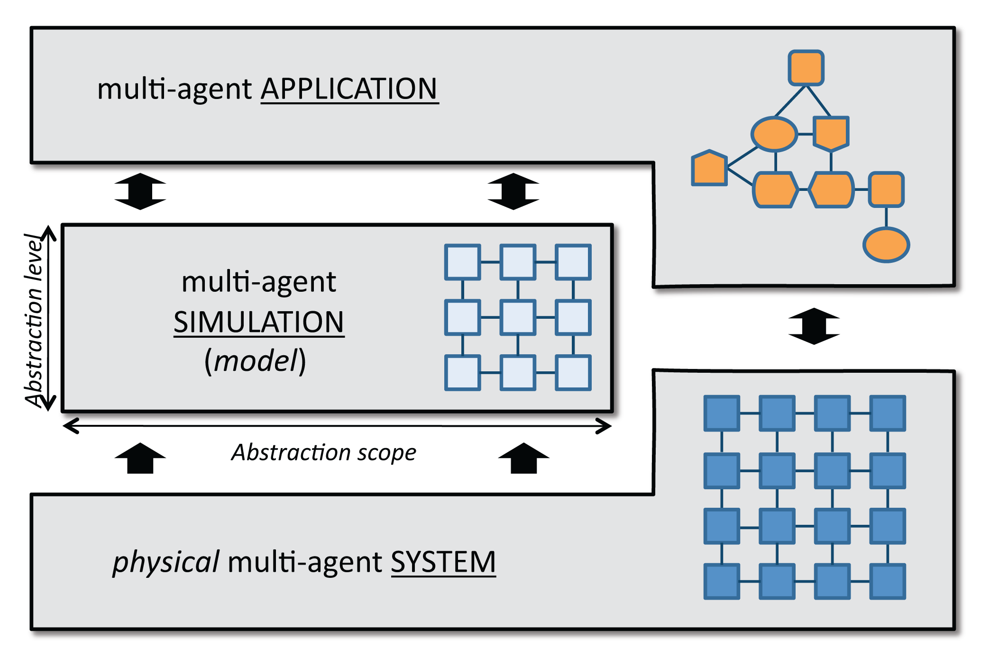
General MASim Architecture

Slide 12
How does MASim supports MA Applications?

Slide 13
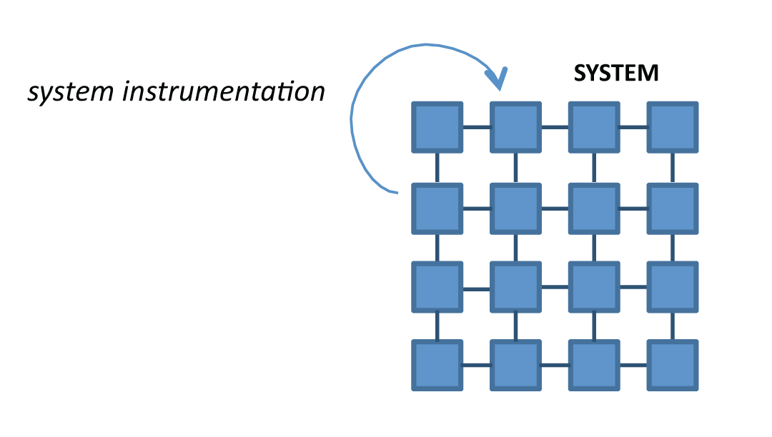

Slide 15
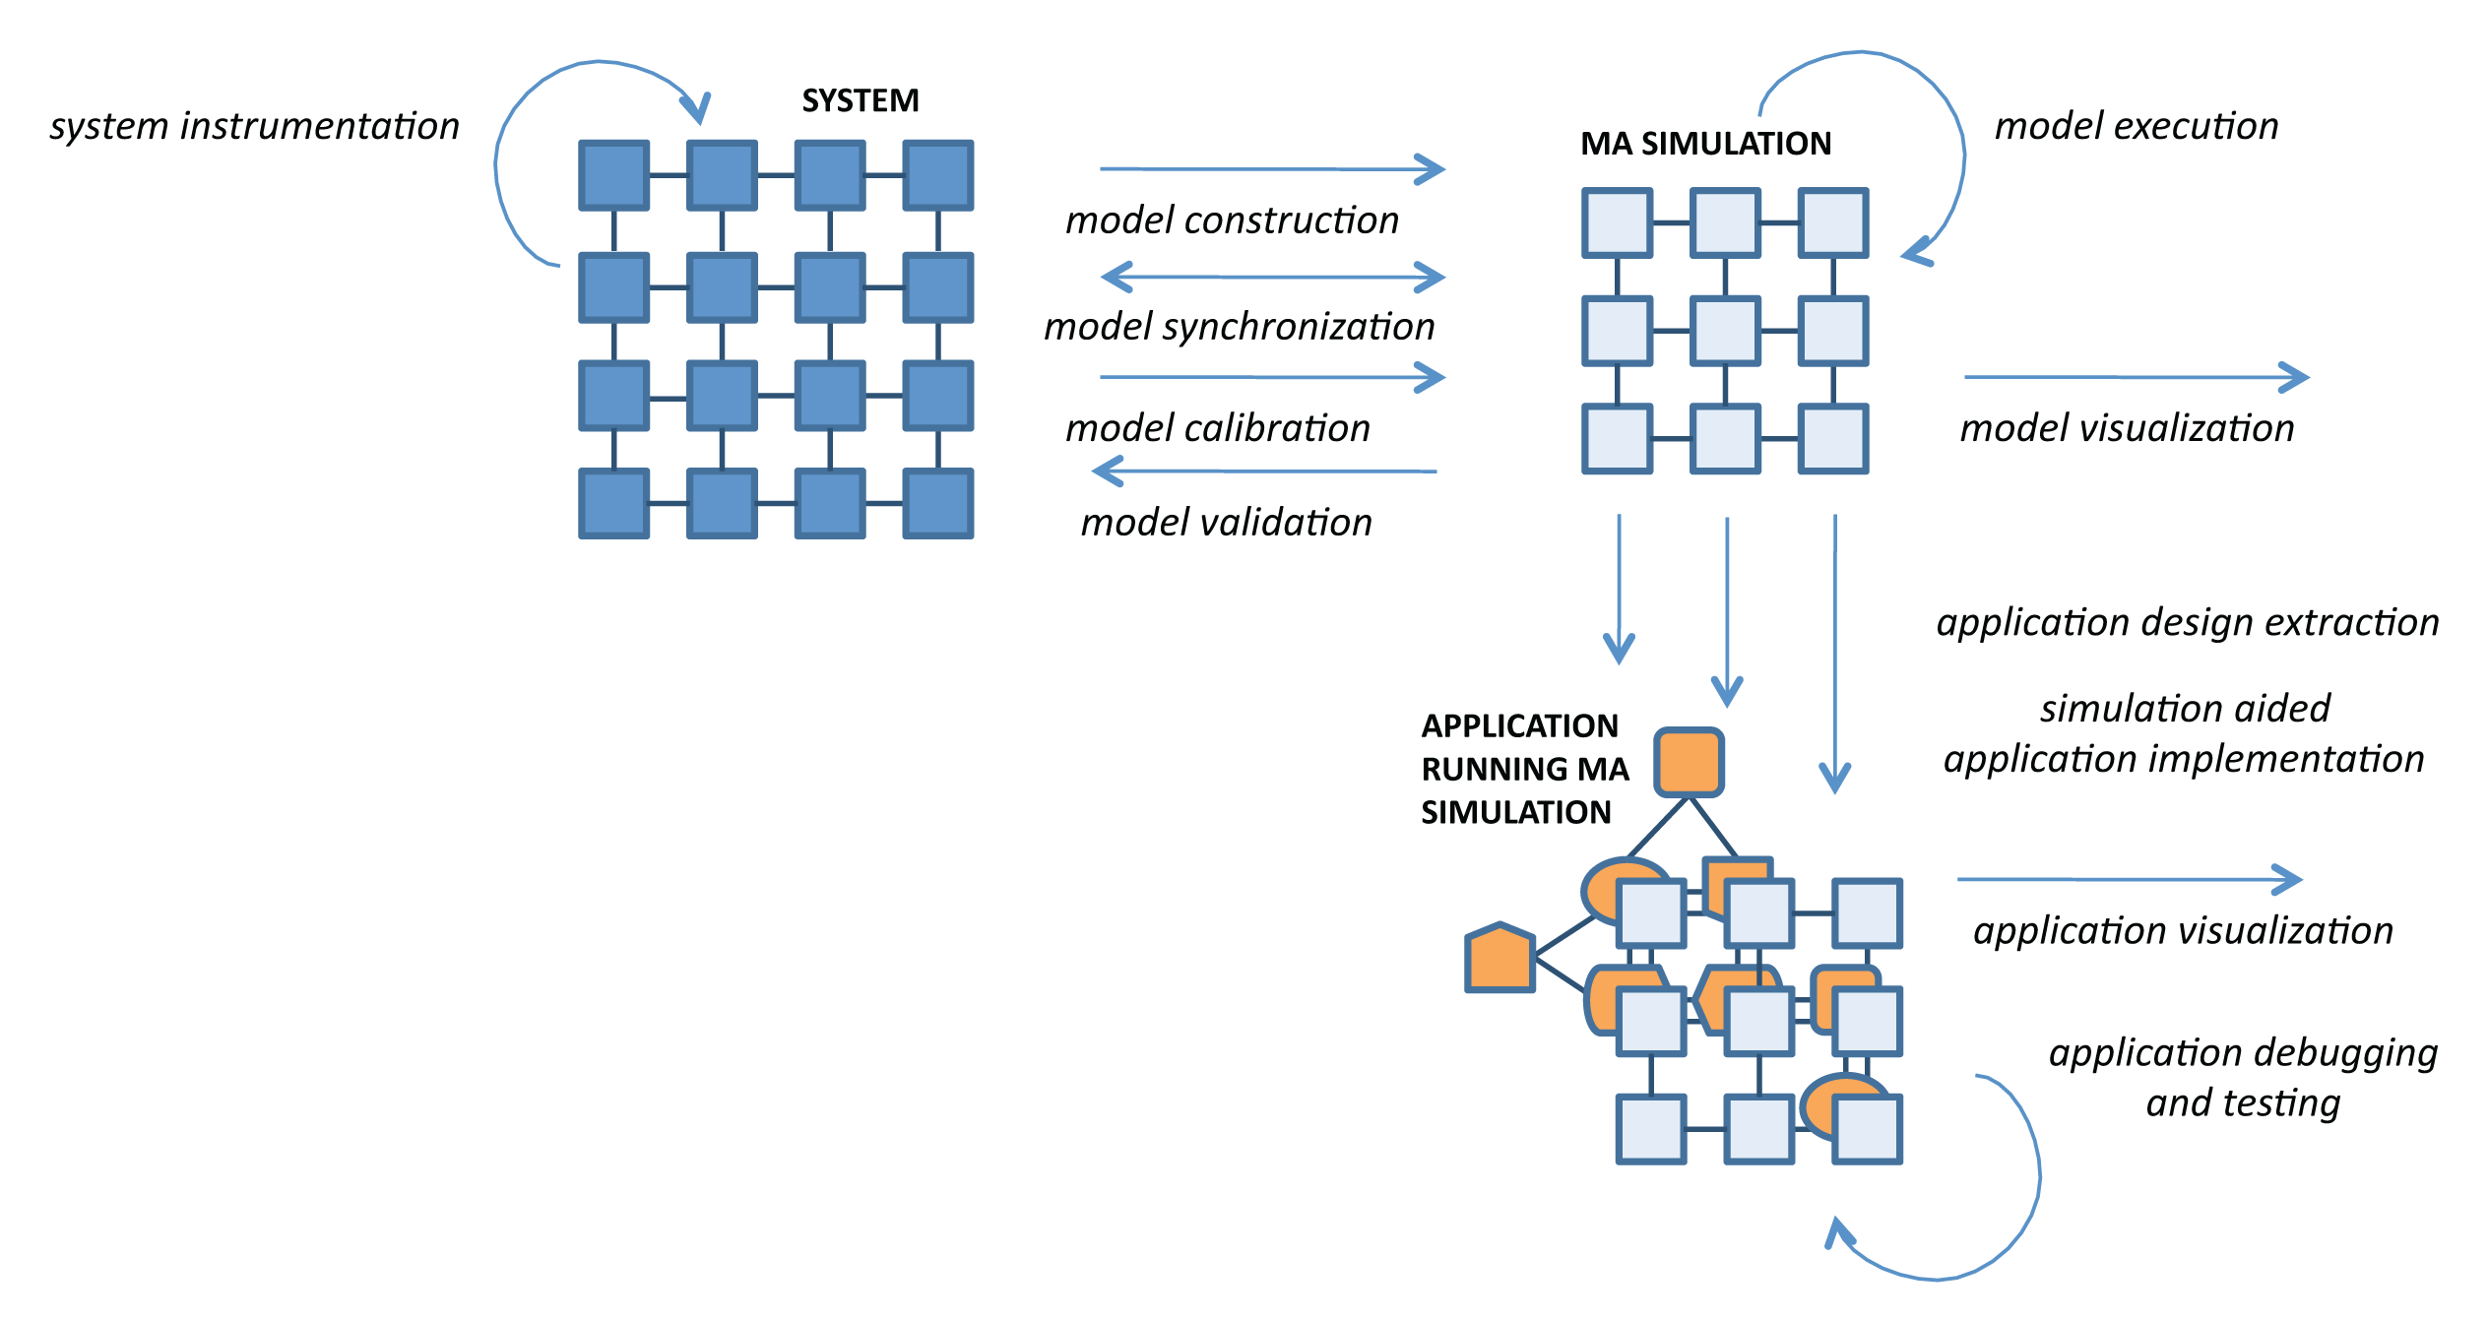

Slide 16
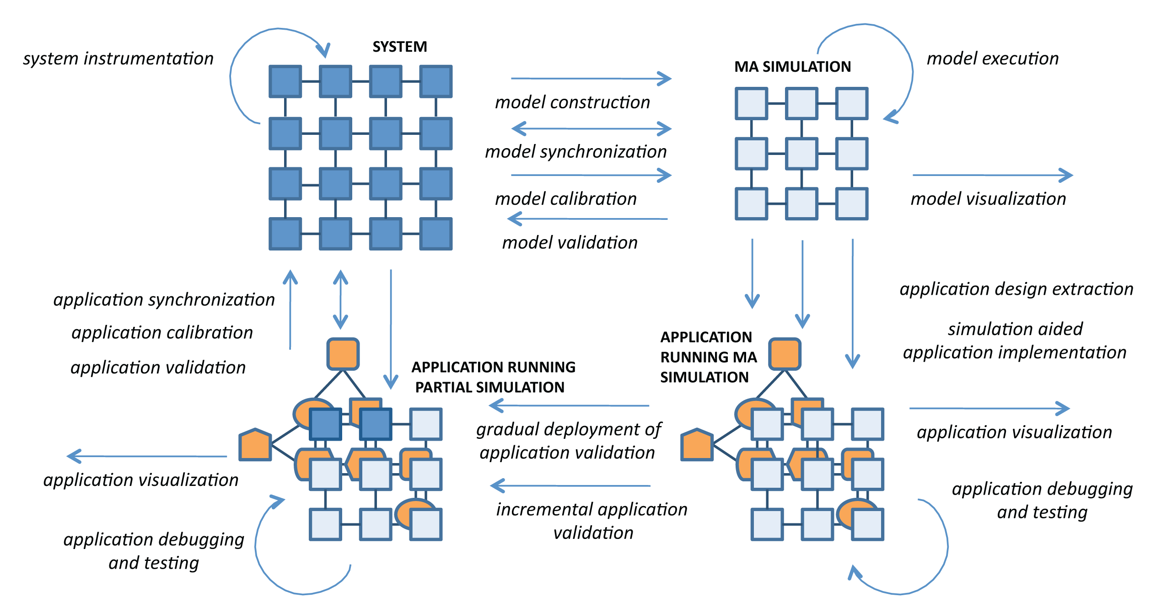

Slide 17
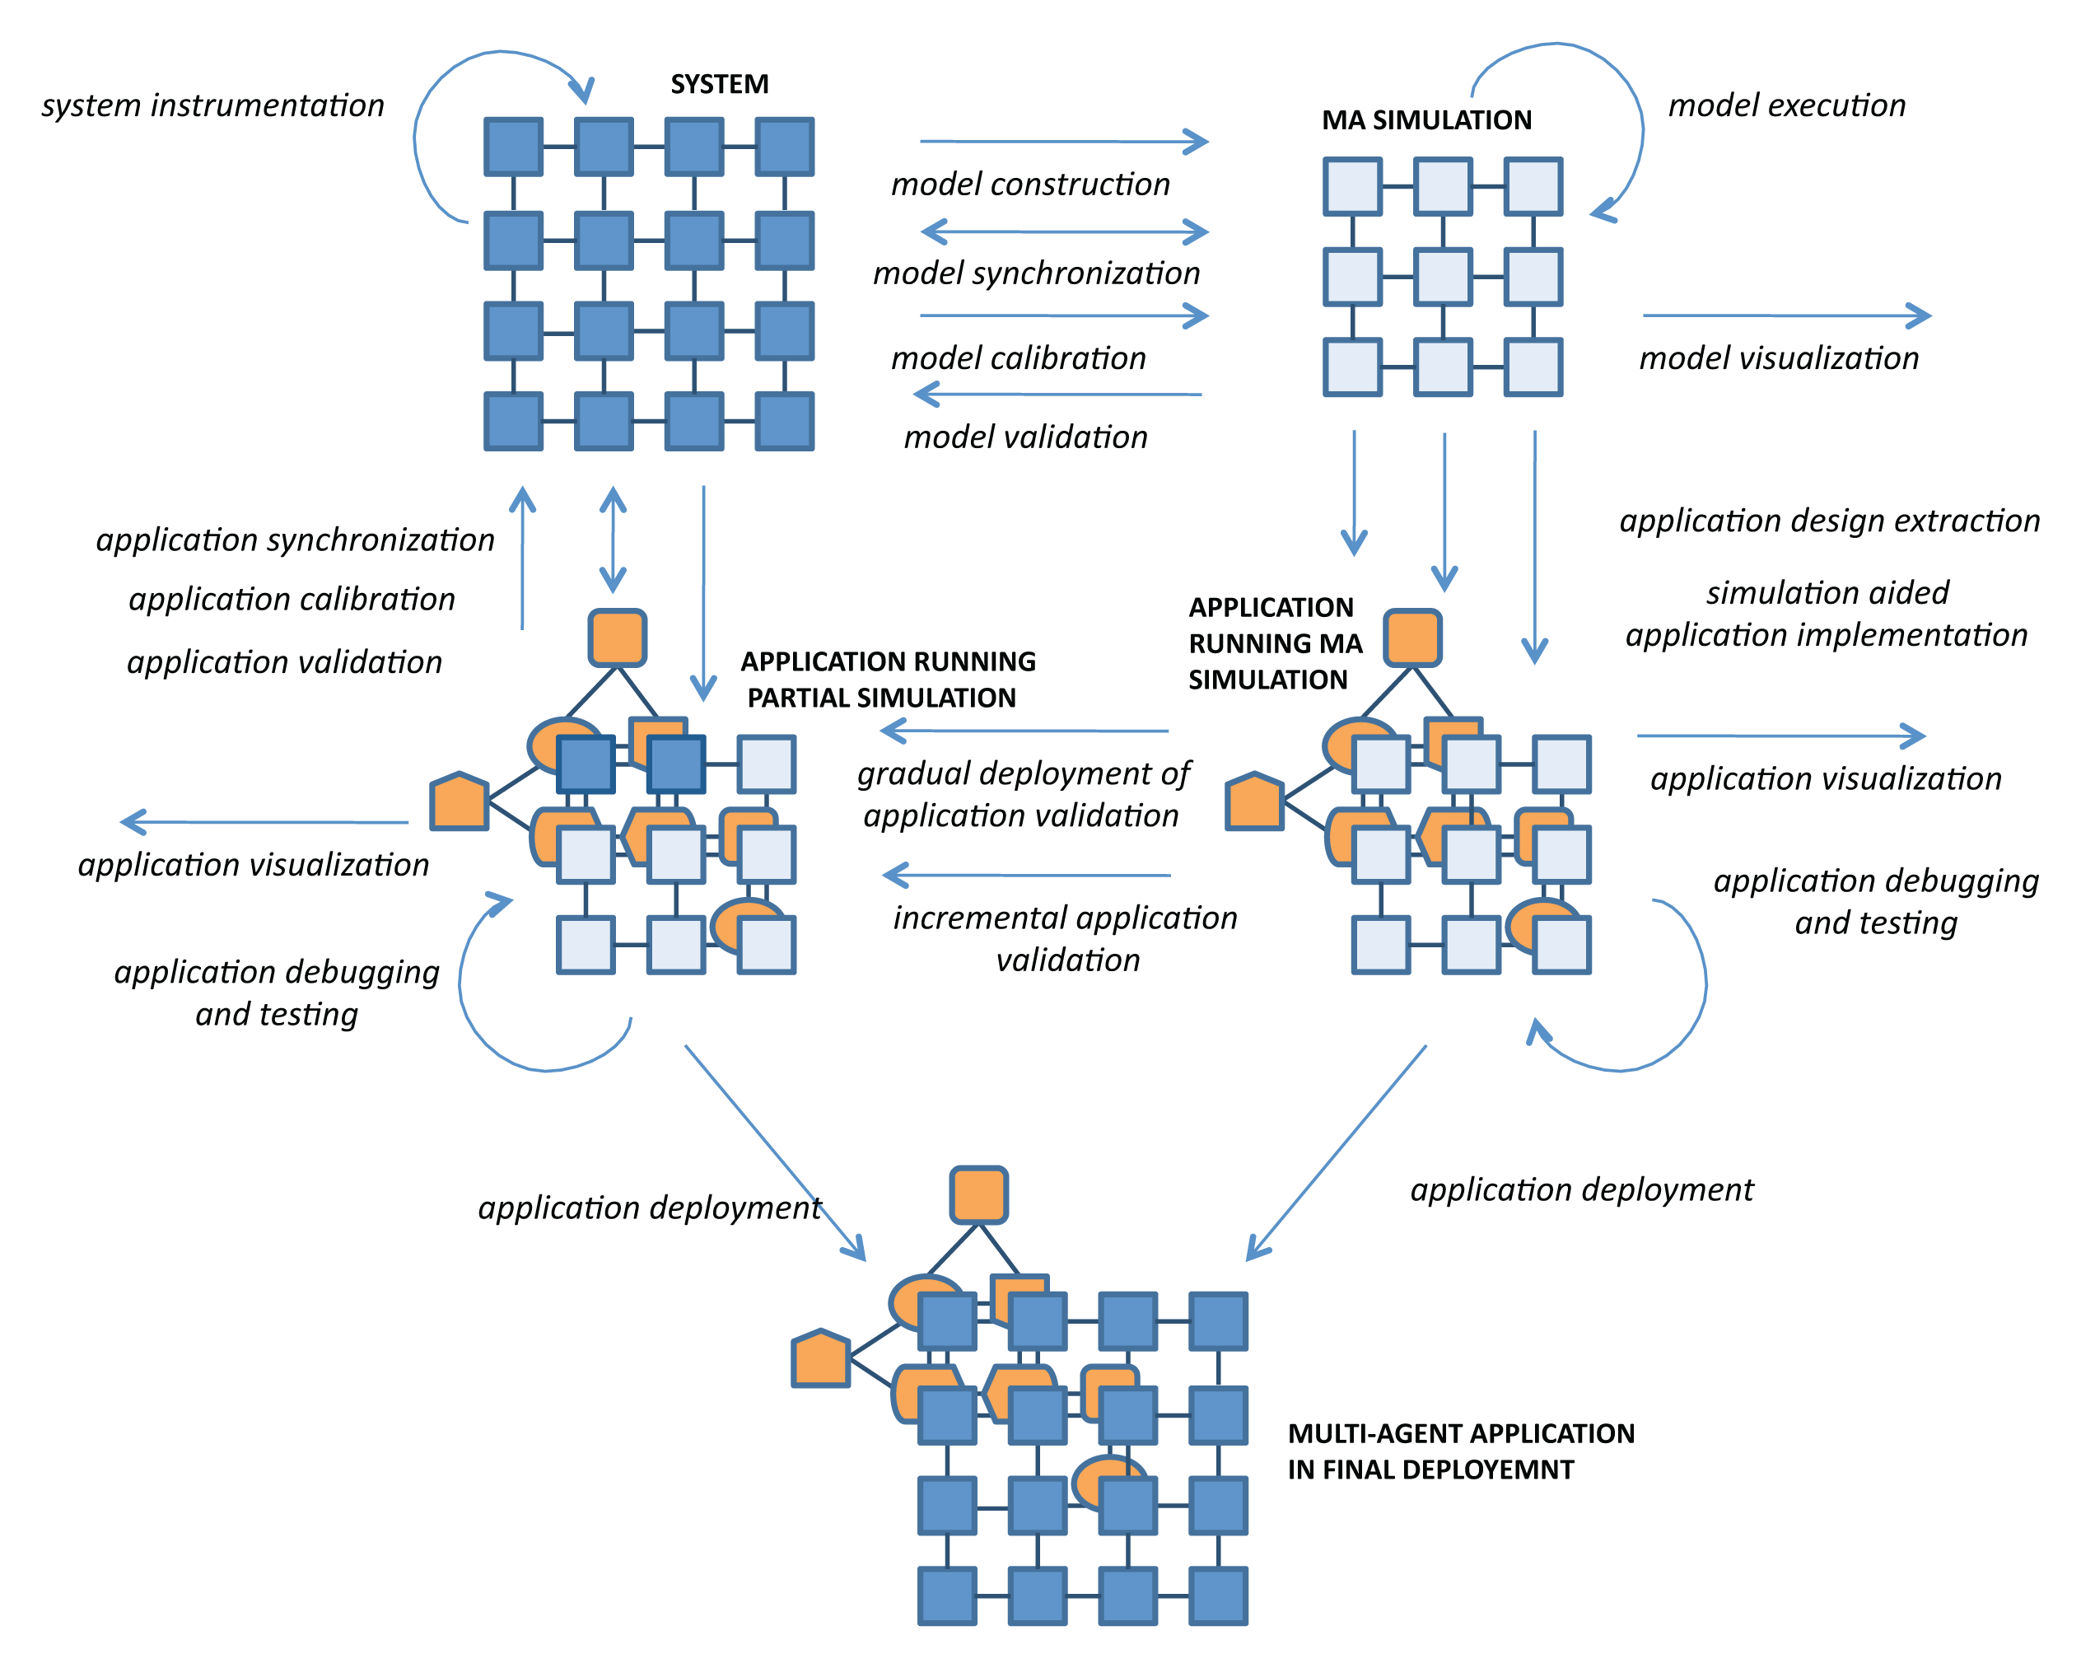

Slide 18
General MASim Process
design and develop the multi-agent simulation
design and develop the target multi-agent application
test and verify behavior of the application on the multi-agent system
debug and improve the multi-agent application so that it works as expected w.r.t. the initial specification,
replace a subset of simulated entities with real-world interfaces,
repeat 4 and 5 while maintaining healthy sync between the initial specification, simulated system and the real-world domain, until the whole simulation is replaced by the real world.

Slide 19
MASim Requirements
Fidelity and scalability – Fidelity of agents’ models, expressivity of comms. and richness of reasoning models. Trade-off between scalability and fidelity.
Concept of Time – Mixed views: some want to study emergent phenomena caused by nondeterminism, some want to control nondeterminism.
Real-time, accelerated time versus long-lived simulation (virtual worlds). Support for empirical work
Round-based/Event-driven/Interaction-driven simulation
Environment – Treating modeling of the environment separately from modeling the agents and their actions:
UAS/UGV robotics, maritime environment, logistics, urban multimodal transit
HW/SW/Human Integration – Support seamless migration of algorithms into physical multiagent environment. Mixed reality simulation. Interaction with HW/Human actors. Integration of real-life data feeds, results from different simulation models
BONUS – Software openness. Community contributors

Slide 20
Examples of MASim Environment
UAS Robotics, Air Traffic Mgt: 3D space, Possible collisions of the assets, Fuel modeling, No flight zones (ground NFZ), Various asset models (BADA), Physics: wind, dynamic models of assets, ATC controllers, sectors
Maritime Environment: 2D space (with NFZ), limited, models of streams
Logistics: Graph nodes and edges (ground and aerial paths), Resources to transport, Various transporting units, Various capacities, additional abilities of the entities – medics, builders, homogeneous transportation
Urban Transport Environment: Graph nodes and edges (paths of multi-modal transportation), Transportation types: subway, trams, buses, cabs, cars, walking, Large-scale graph, Complex environment (building types, road types, traffic system, …), Complex interactions (getting on/off transport, traffic congestion, jams, traffic lights, durations, …), Transport capacities

Slide 21
Principal Approaches to MASim
Real-time/accelerated-time simulations
Round-based/Event-driven/Interaction-driven simulation
Centralized versus fully decentralized simulations

Slide 22
ATG in-house MASim Environment
In house built ATG infrastructures that are in part meeting the listed requirements:

Slide 23
AGENTFLY Architecture
AGLOBE: JADE-like fully fledged multi-agent OS (platform) and development environment (JAVA-based)
special tailored for high scalability (due to natural decentralization)
provides specialized environment simulation component
suitable for seamless distribution for parallel computing
suitable for hardware integration and partial/hybrid simulation
can be used as is for robotics
SOTA techniques in thread management, non-blocking algorithms, native I/O buffers and pooling of critical structures, platform/container/service/agent model using event-driven architecture
IP-less configuration – automatic discovery
address/topic based very fast uni/multi-casted messaging
advanced agent mobility and computational reflection

Slide 24
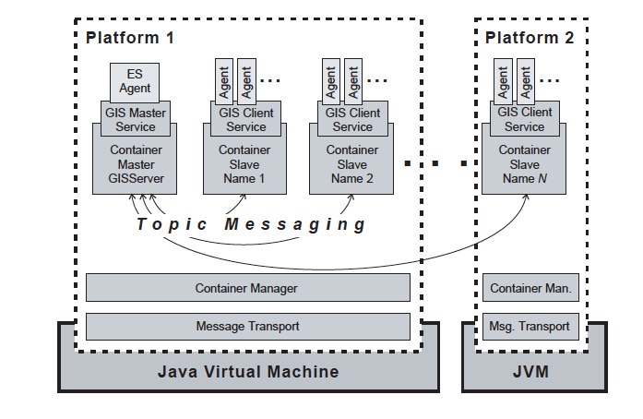
AGENTFLY Architecture
AGLOBE: JADE-like fully fledged multi-agent OS (platform) and development environment (JAVA-based)
special tailored for high scalability (due to natural decentralization)
provides specialized environment simulation component
suitable for seamless distribution for parallel computing
suitable for hardware integration and partial/hybrid simulation
can be used as is for robotics
SOTA techniques in thread management, non-blocking algorithms, native I/O buffers and pooling of critical structures, platform/container/service/agent model using event-driven architecture
IP-less configuration – automatic discovery
address/topic based very fast uni/multi-casted messaging
advanced agent mobility and computational reflection

Slide 25
ATG in-house MASim Environment
In house built ATG infrastructures that are in part meeting the listed requirements:
AGLOBE SIMULATION: JADE-like fully fledged multi-agent platform and development environment (JAVA-based)
supports agent mobility
special tailored for high scalability (due to natural decentralization)
provides specialized environment simulation component (XSIMULATION)
suitable for seamless distribution for parallel computing
suitable for hardware integration and partial/hybrid simulation
can be used as is for robotics
high software development rump-up time

Slide 26
ATG in-house MASim Environment
In house built ATG infrastructures that are in part meeting the listed requirements:
AGLOBE/SIMULATION: JADE-like fully fledged multi-agent platform and development environment (JAVA-based)
supports agent mobility
special tailored for high scalability (due to natural decentralization)
provides specialized environment simulation component (XSIMULATION)
suitable for seamless distribution for parallel computing
suitable for hardware integration and partial/hybrid simulation
can be used as is for robotics
high software development rump-up time

Slide 27
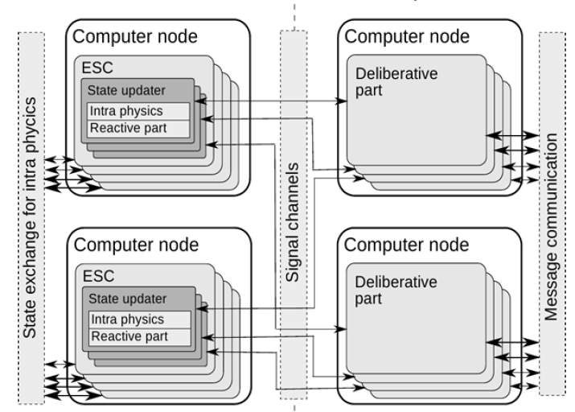
ATG in-house MASim Environment
In house built ATG infrastructures that are in part meeting the listed requirements:
AGLOBE/SIMULATION: JADE-like fully fledged multi-agent platform and development environment (JAVA-based)
supports agent mobility
special tailored for high scalability (due to natural decentralization)
provides specialized environment simulation component (XSIMULATION)
suitable for seamless distribution for parallel computing
suitable for hardware integration and partial/hybrid simulation
can be used as is for robotics
high software development rump-up time

Slide 28
ATG in-house MASim Environment
In house built ATG infrastructures that are in part meeting the listed requirements:
AGLOBE SIMULATION: JADE-like fully fledged multi-agent platform and development environment (JAVA-based)
supports agent mobility
special tailored for high scalability (due to natural decentralization)
provides specialized environment simulation component (XSIMULATION)
suitable for seamless distribution for parallel computing
suitable for hardware integration and partial/hybrid simulation
can be used as is for robotics
high software development rump-up time

Slide 29
ATG in-house MASim Environment
In house built ATG infrastructures that are in part meeting the listed requirements:
AGLOBE SIMULATION: JADE-like fully fledged multi-agent platform and development environment (JAVA-based)
supports agent mobility
special tailored for high scalability (due to natural decentralization)
provides specialized environment simulation component (XSIMULATION)
suitable for seamless distribution for parallel computing
suitable for hardware integration and partial/hybrid simulation
can be used as is for robotics
high software development rump-up time
used by IHMC, FAA, FL3XX, BAE Systems, CADANCE Design Systems, US AirForce, US Army, TU-MUNICH.

Slide 30
AGLOBE Architecture

Slide 31
AGLOBE/XSIMULATION

Slide 32
ATG in-house MASim Environment
In house built ATG infrastructures that are in part meeting the listed requirements:
ALITE SIMULATION: The simulation engine, is the central component of any ALITE multi-agent system.
provides full control of non-determinism in the system
individual probability distributions of events in the system can be set
superb for tests and experiments
lower software development rump-up time
special tailored for high scalability (due to low-overhead code design)
does not support hardware migration and partial/hybrid simulation

Slide 33
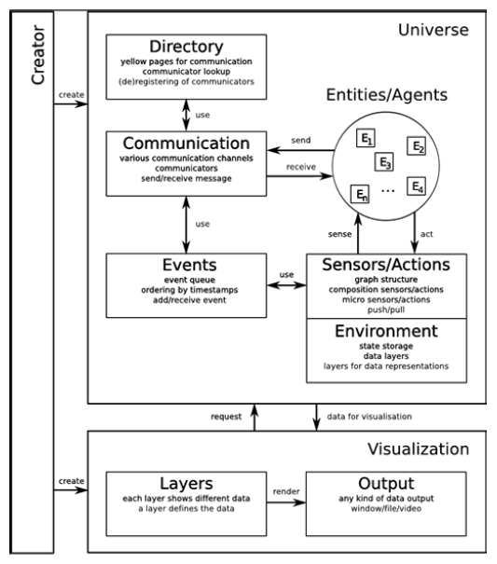
ATG in-house MASim Environment
In house built ATG infrastructures that are in part meeting the listed requirements:
ALITE SIMULATION: The simulation engine, is the central component of any ALITE multi-agent system.
provides full control of non-determinism in the system
individual probability distributions of events in the system can be set
superb for tests and experiments
lower software development rump-up time
special tailored for high scalability (due to low-overhead code design)
does not support hardware migration and partial/hybrid simulation

Slide 34
ALITE/XSIMULATION

Slide 35
ATG in-house MASim Environment
In house built ATG infrastructures that are in part meeting the listed requirements:
ALITE SIMULATION: The simulation engine, is the central component of any ALITE multi-agent system.
provides full control of non-determinism in the system
individual probability distributions of events in the system can be set
superb for tests and experiments
lower software development rump-up time
special tailored for high scalability (due to low-overhead code design)
does not support hardware migration and partial/hybrid simulation

Slide 36
ATG in-house MASim Environment
In house built ATG infrastructures that are in part meeting the listed requirements:
ALITE SIMULATION: The simulation engine, is the central component of any ALITE multi-agent system.
provides full control of non-determinism in the system
individual probability distributions of events in the system can be set
superb for tests and experiments
lower software development rump-up time
special tailored for high scalability (due to low-overhead code design)
does not support hardware migration and partial/hybrid simulation
used within the projects funded by US ARMY CERDEC, ONR and IBM

Slide 37
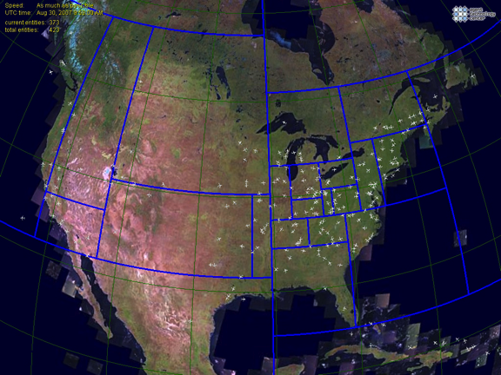
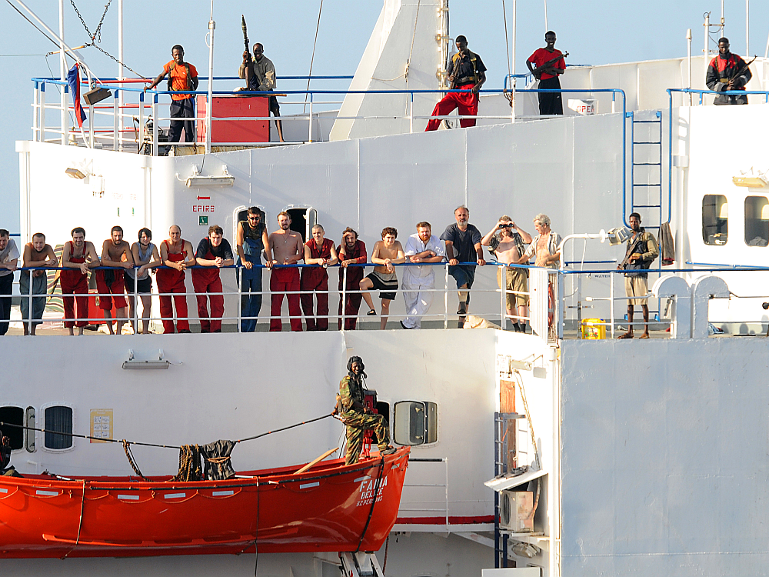
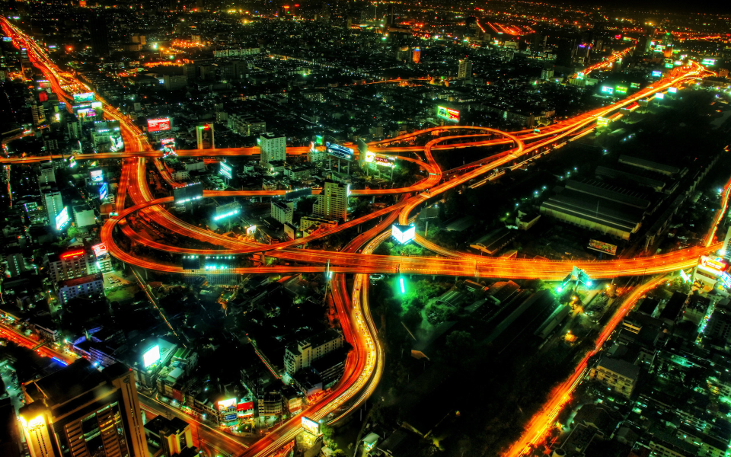
Case Studies
UAV/ATM maritime piracy urban traffic
Notes:
10 MIN

Slide 38
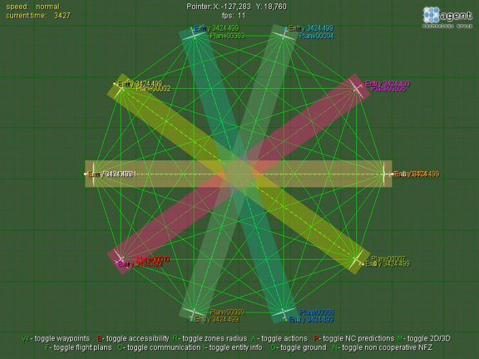
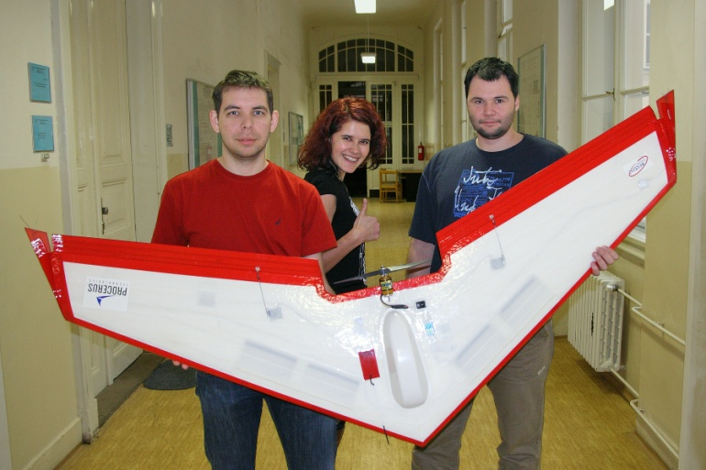
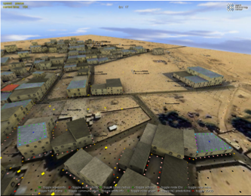
Notes:
Explain that now comes several demos and use cases of multi-agent simulation

Slide 39
Free-flight UAV traffic control
Free-flight planning and re-planning of collision free trajectory for multiple aerial autonomous systems: planning/control + demo
deployment exercise with the technological objective to:
fly higher number of aircrafts in restricted airspace
decrease cognitive load and the need for direct human involvement
allow combination of cooperative and non-cooperative deconfliction
the research objective was to investigate theoretically and empirically:
efficiency of free-flight concept
robustness of free-flight concept
scalability of free-flight concept
Notes:
To explain better: Problem spec
In technology ~ can multiagent systems enable free-flight and what are the implication and added value
In research ~ what is the scalability and safety of free flight

Slide 40
Free-flight UAV traffic control
Free-flight planning and re-planning of collision free trajectory for multiple aerial autonomous systems: planning/control + demo
Technical approach:
Scalable multi-agent simulation of a high number of the deliberative, computational entities.
Negotiation-based decentralized coordination - computational capability to transform the set of time specific waypoints into a smooth trajectory
Efficient and fast planning algorithms - computational capability to transform the set of time specific waypoints into a smooth trajectory
Accelerated A* planners
Distributed planning linked with deconfliction capability
Notes:
To explain better: Problem spec
In technology ~ can multiagent systems enable free-flight and what are the implication and added value
In research ~ what is the scalability and safety of free flight

Slide 41
Accelerated A* (AA*) Algorithm
State-of-the-art (briefly):
Fast: Rapid Random Trees (RRT), Random Walk Planners (RWP) and Randomized Potential Fields (RPF)
Optimal: Vector fields and potential fields
AA* provides sub-optimal trajectory with given distance to optimum
More than 1000 times faster than A* algorithm
AA* concept:
adaptive sampling (q = p, 2*p, 4*p, 8*p, 16*p, 32*p, 64*p, …)
rare sampling density in open spaces / higher density closer to obstacles
removes trade-off between speed and search precision
progressive path smoothing – every generated path is smoothed
similarity checks – used for OPEN and CLOSED operations
heuristic function – based on Dubin car
Notes:
In the core of our work there is AA* a performance-optimized planner that has been first presented 2 years ago in AAMAS/ICAPS.
Properties from the slide
It is fast (we need it to be as it has been mainly used for peer-to-peer collision avoidance)
One dimension of scalability (the planner needs to be executed many times on one collision)
The different level of scalability: used for many aircrafts at the same time
Adaptive sampling: sampling step is computed based on how far is an obstacle or a waypoint. See examples.
Progressive path smoothing: and the CLOSED list is crosschecked for cheaper trajectories within a smaller, well defined region.
Similarity check: to prevent infinite loops given by the space sampling – new states are checked whether they are q/2 from some on the lists
Use of heuristcs? We do not use mere connection but Dubin car shortest smooth trajectory.
The operation/speed of the AA* is given by the number of obstacles (SUA) in the scenario. Very high number of SUA in NAS representa a serious thread to speed, mainly in computing:
Intersection test a
Distance to nearest obstacle for adaptivni sampling (krok).
All this has been slow even if AA* uses tree strukturs for acceleration of all the computational process with them.

Slide 42
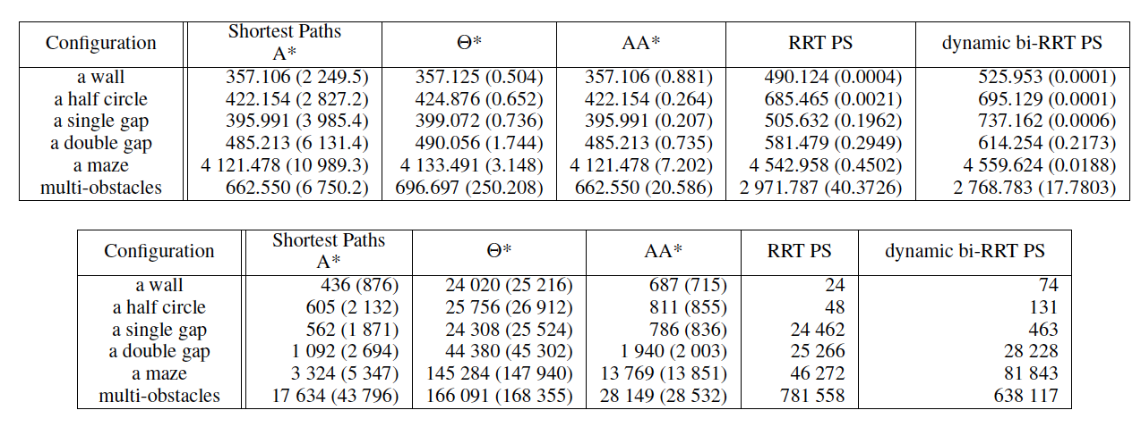
AgentFly trajectory planning, video
Notes:
Three planning tasks in AgentFly: [1] mission planning (setting WP), [2] robotics trajectory planning [3] planning deconfliction manuvers
Our contribution is FAST, Real-time planning : we have implemented the AA* planner, which is deterministic (not randomized) and is fast.
The key idea: adaptive computation of the a relevant search step and backward smoothing algorithm

Slide 43
Planning in AgentFly
Notes:
Low computational requirements in 1
Scalability and effectiveness in 2
Openness towards different deconfliction methods in 3

Slide 44
Deconfliction in AgentFly
Cooperative deconfliction
Rule-based collision avoidance (RBCA) – using existing FAA visual flight rules that performs avoidance manoeuver without interaction
Iterative peer-to-peer collision avoidance (IPPCA) – based on pair-wise negotiation between couples of assets for pareto-efficient manoeuver
Multi-party collision avoidance (MPCA) – extension of IPPCA to any-size-group mutually nonconflicting assets
Noncooperative deconfliction
Based on modeling unknown objects and prediction of their trajectory communication

Slide 45
superconflict scenario – Iterative peer-to-peer deconfliction

Slide 46
superconflict – mixed multi-algorithm deconfliction, video

Slide 47
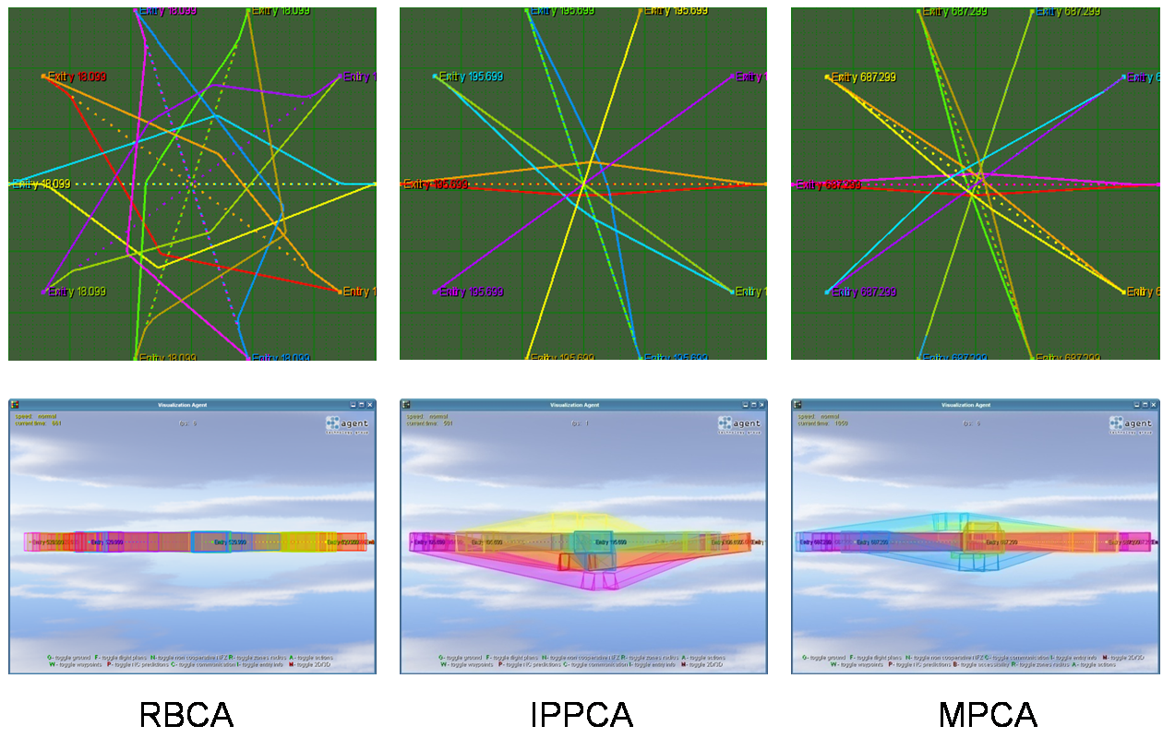
Deconfliction - comparison

Slide 48
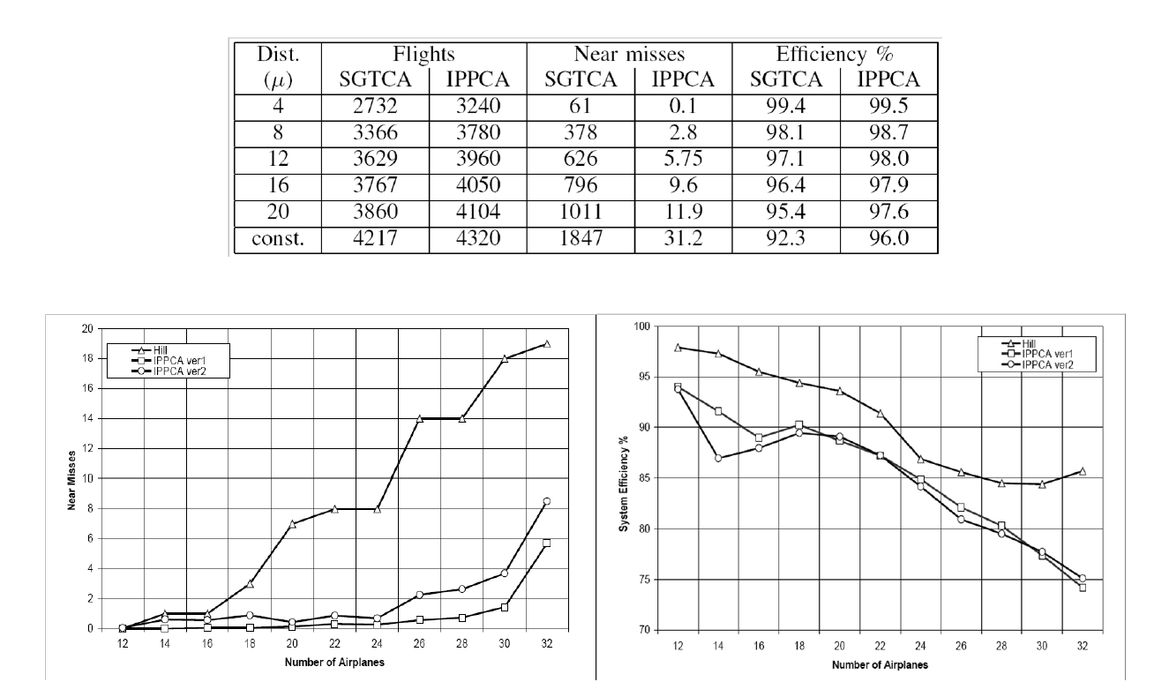
Further tests and experiments
video
video
Notes:
[1] we did a lot of tests on the benchmark scenarios

Slide 49
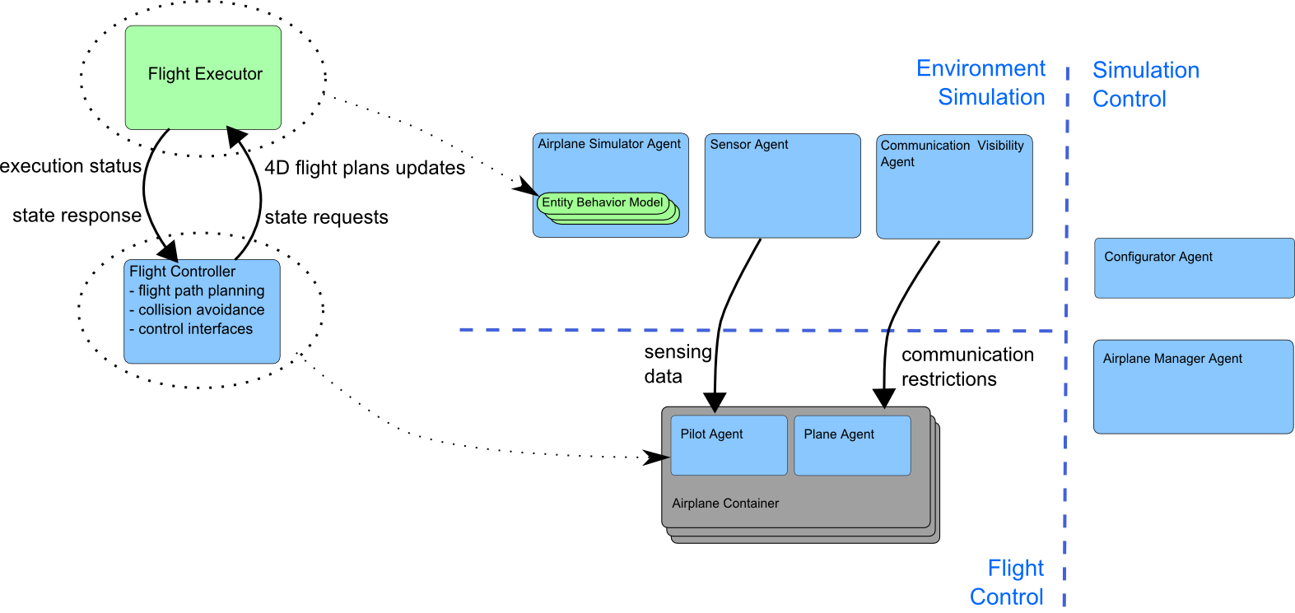
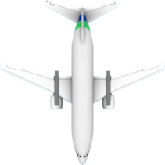
AGENTFLY Architecture
Notes:
AGENTFLY utilizes the model of decoupled environment simulation (including flight simulation and sensing computation) and flight control algorithms

Slide 50
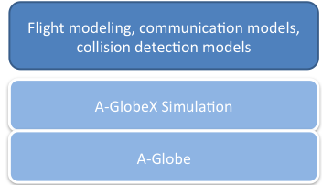
AgentFly & MASim
planning
deconfliction
sensing
civilian traffic
geography
UAVS

Slide 53
Accelerated A* (AA*) Algorithm
Highly efficient optimization-based search method
Provides sub-optimal trajectory with guaranteed difference to the optimal one
More than 1000 times faster than A* algorithm
AA* concept:
adaptive sampling (q = p, 2*p, 4*p, 8*p, 16*p, 32*p, 64*p, …)
rare sampling density in open spaces / higher density closer to obstacles
removes trade-off between speed and search precision
progressive path smoothing – every generated path is smoothed
similarity checks – used for OPEN and CLOSED operations
heuristic function – based on Dubin car
AA* challenge:
Speed/operation is given by the number of obstacles in the space in
(i) intersections test and (ii) adaptive sampling
Notes:
In the core of our work there is AA* a performance-optimized planner that has been first presented 2 years ago in AAMAS/ICAPS.
Properties from the slide
It is fast (we need it to be as it has been mainly used for peer-to-peer collision avoidance)
One dimension of scalability (the planner needs to be executed many times on one collision)
The different level of scalability: used for many aircrafts at the same time
Adaptive sampling: sampling step is computed based on how far is an obstacle or a waypoint. See examples.
Progressive path smoothing: and the CLOSED list is crosschecked for cheaper trajectories within a smaller, well defined region.
Similarity check: to prevent infinite loops given by the space sampling – new states are checked whether they are q/2 from some on the lists
Use of heuristcs? We do not use mere connection but Dubin car shortest smooth trajectory.
The operation/speed of the AA* is given by the number of obstacles (SUA) in the scenario. Very high number of SUA in NAS representa a serious thread to speed, mainly in computing:
Intersection test a
Distance to nearest obstacle for adaptivni sampling (krok).
All this has been slow even if AA* uses tree strukturs for acceleration of all the computational process with them.

Slide 54
Iterative Accelerated A* (IAA*)
Extension of AA*
Preprocessing of the environment (obstacle hierarchy) in order to decrease the number of obstacle intersection tests
Key concepts
Run the AA* algorithm iteratively in order to reduce number of obstacle intersection tests
Select subset of obstacles based on the start and goal position of planning
Run the algorithm with a subset of obstacles and then test the produced plan for intersection against all obstacles in the domain
If the test is positive (the plan intersects any obstacle), extend the subset of obstacles
If the test is negative, the plan is valid and may be applied
Notes:
In order to be able to accelerate the computation we are limitting the max of the number of SUAs in a sub-set – how the subeset is created see next slide.
Each plan is further tested on the whole space and is rejected if there is interesection as a solution.
- Testing is only during the test phase and not during the state-space expansion (therefore this operation is not carried our exponentional times but inly linear times wrt to the length of the flight distance)
It is clear that this approach converges – it always finds a solution if one exists, as the worst case gets ourselves to ful NAS.

Slide 55
Selection of Obstacle Sub-set
Filter-out most of irrelevant obstacles to speed-up AA* algorithm
Selection mechanism – include obstacles which lies inside α area around:
straight trajectory between start and goal positions for the first iteration
the resulting trajectory from the previous iteration for subsequent iterations
α parameter is selected based on the length of trajectory
Notes:
Main taks is to filter out all the irrelevant obstacles (napr. Planujes let mezi JFK a Wash DC, tj. neni treba v planovani vubec pouzivat zony na zapadnim pobrezi USA).
The size of the sub-set is monotonically increasing
Worst case: sub-set = all
If in one iteration there is no solution => the problem does not have a solution
Velikost okoli (alfa) bere automaticky jako dana cast delky te rozhodne trajektorie (na zadatku vzdalenosti start-goal, pak delky reseni tech predchozich iteraci). Often set to 10%
Pro prvni iteraci se zony vyberou z oblasti okolo (carkovana cara na obrazku) nejkratsi spojnice mezi startem a cilem (teckovana cara na obrazku) coz po te slouzi k tomu, ze takto spustene AA* nemuze najit jako reseni tuto spojnici, protoze tam bude lezet nejaka prekazka. V dobrem pripade se podari najit v teto iteraci trajektorii ktera lezi uvnitr te oblasti. Pak to znamena ze vlastne mame vyhrano a dalsi iterace neni potreba, neexistuje zadna dalsi prekazka ktera by nejak zasahovala do carkovane oblasti. Pokud trajektorie vyboci, muze se stat ze se testem na teto vysledne trajektorii vuci vsem prekazkam najde misto kde se protne nejaka prekazka, ktera drive nebyla v teto iteraci zahrnuta. V takovem pripade, k predchozimu setu prekazek se pridaji dalsi prekazky z dalsiho takoveho carkovaneho okoli kolem trajektorie kterou to naslo predtim. Tj. budou tam zahrnuty i prekazky se kterymi ma tato cesta intersection.

Slide 56
Empirical Evaluation
Sum of run-times of the planner over 369 flights (1% of the traffic)
Total # of obstacles used for tests
Notes:
Tested on real traffic data in the U.S. NAS:
complete data set as of August 31, 2007
Comparison of AA* and IAA*:
measured the total time spent in planning phase over all airplanes for five configurations of the minimal planning step of the AA*
planning step in meters
Measured for three different configurations of obstacle inclusion parameter α
Comparison with the original AA* algorithm
Tady jsou vysledky, horni tabulka (soucet vsech casu planovani pres vsechny letadla), dole (soucet vsech zon pouzity v posledni iteraci planovani pres vsechny letadla).
Tabulky maji 2 dimenze, sloupce jsou podle zvoleneho minimalniho planovaciho kroku v metrech (tj. nevetsi mozna densita samplovani), tento parametr je shodny pro IAA* a take pro AA*. Radky tabulky jsou ruzne inklusni faktory 0.1, 0.3, 0.5 a AA* (coz odpovida pouziti vsech SUA a jen jedne iteraci).
Z vysledku je patrne, ze pro nejvetsi akcelerace je dosahovana pro 0.1 (okoli velikosti jedne desetiny delky trajektorie). Druha tabulka dokumentuje jak se lisi pocet obstaclu podle ruzne hodnoty toho inkluzniho faktoru.

Slide 57
AGENTC Adversarial Modeling and Reasoning in the Maritime Domain
Michal Jakob, Ondřej Vaněk, Štěpán Urban, Petr Benda and Michal Pěchouček (PI)
Agent Technology Center
Dept. of Cybernetics, FEE, Czech Technical University
Prague, Czech Republic
http://agents.felk.cvut.cz
Supported by the Office Of Naval Research grant no. N00014-09-1-0537
Notes:
40 MIN
The problem here is to design mechanisms and algorithms that ought to provide Secure Transit through Hostile Maritime Area:
the project has been addressed from two different directions:
[1] Designing of algorithms
[2] Validation on multi-agent simulation

Slide 58
Secure Multi-Agent Hostile Area Transit
Incentive-compatible convoy formation
transiting vessels
Risk-aware transit routing
(Hostile Area Transit Game)
non-cooperative (adversarial)
cooperative
cooperative
pirate vessels
non-cooperative (adversarial)
Deterrence maximizing patrolling
(Mobile Target Patrolling Game)
AGENTC
military patrols
Notes:
In the problem there are the following interactions with different level of adversarial behavior:
Our contribution was: [1] computing secure trajectories for transiting vessels [2] interaction based algorithm for convoy formation [3] deference maximizing military patrols patterns

Slide 59
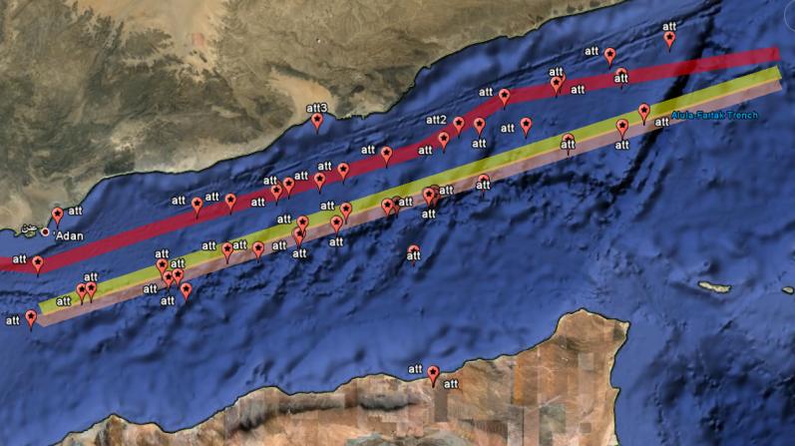
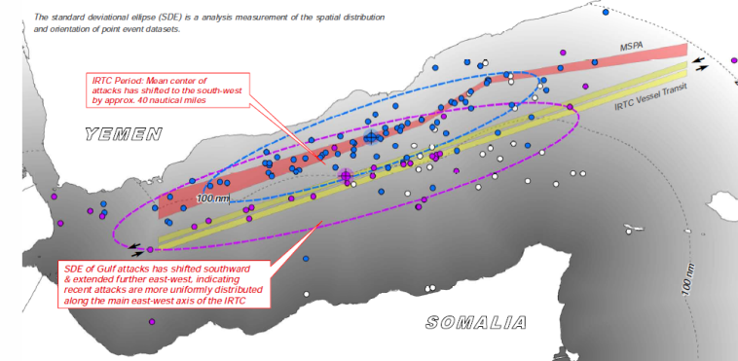
Risk-aware Transit Routing
Pirates adapt to transit traffic patterns
=> Randomize the choice of the transit trajectory in order to make ambush more difficult
=> Utilize game theory to find optimum randomization
Notes:
To HIDE

Slide 60
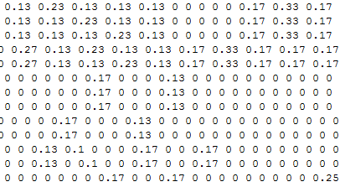
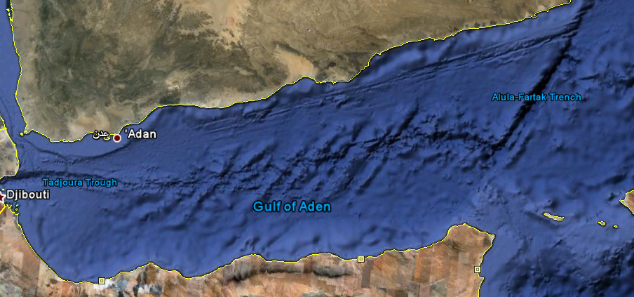
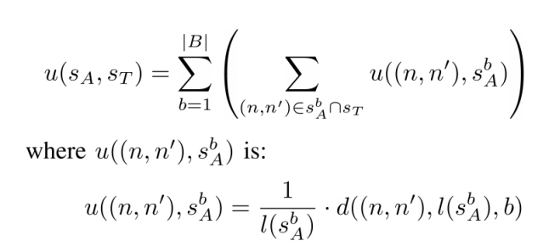
Risk-aware Transit Routing
Game Matrix
Attacker strategies (= closed walks)
…
W68
W69
…
Transporter strategies (= transit routes)
…
P32
.17
0
…
…
P33
.06
.33
…
…
…
Attacker payoffs (= -transporter payoffs)
P32
Destination
Origin
P33
W69
Transporter
W68
Attacker
Base
Notes:
Pirates adapt to transit traffic patterns
[1] Randomize the choice of the transit trajectory in order to make ambush more difficult
[2] Utilize game theory to find optimum randomization

Slide 61
Hostile Area Transit Game
Game Matrix
Attacker strategies (= closed walks)
Transport graph
…
W68
W69
…
Transporter strategies (= transit routes)
…
P32
.17
0
…
…
P33
.06
.33
…
…
…
Pirate graph
Attacker payoffs (= -transporter payoffs)
P32
Destination
Origin
P33
W69
Transporter
W68
Attacker
Base

Slide 62
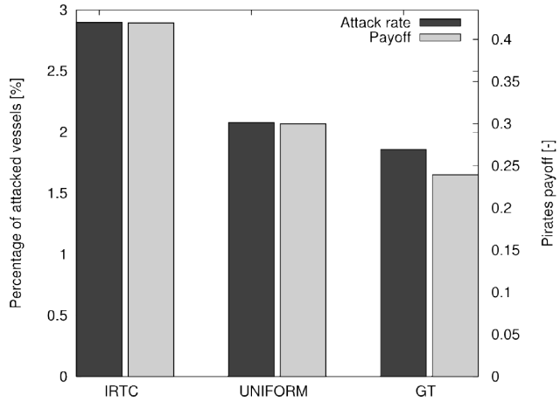
Hostile Area Transit Game
Game Matrix
Attacker strategies (= closed walks)
…
W68
W69
…
Transporter strategies (= transit routes)
…
P32
.17
0
…
…
P33
.06
.33
…
…
…
Attacker payoffs (= -transporter payoffs)
P32
Destination
Origin
P33
W69
Transporter
W68
Attacker
Base

Slide 63
Secure Multi-Agent Hostile Area Transit
Incentive-compatible convoy formation
transiting vessels
Risk-aware transit routing
(Hostile Area Transit Game)
non-cooperative (adversarial)
cooperative
cooperative
pirate vessels
non-cooperative (adversarial)
Deterrence maximizing patrolling
(Mobile Target Patrolling Game)
AGENTC
military patrols
Notes:
[1] the problem of DM Patrolling is modeled as a mobile target patrolling game. Optimal solution is found by linear programming
[2] convoy formation has been solved as a cooperative game (by means of coalition formation approaches) and has shown savings in time and speed – while the number of incidents has been unchanged

Slide 64
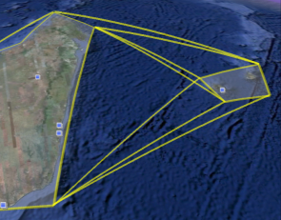
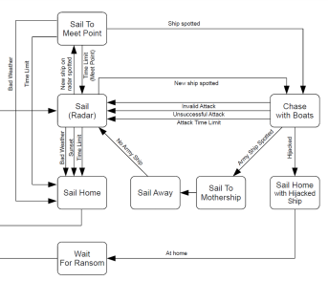
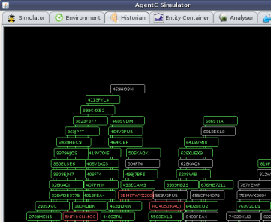
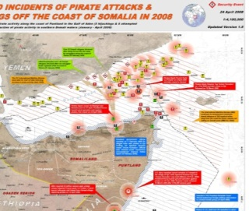
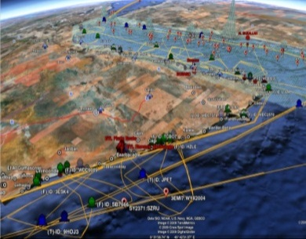
AGENTC Simulation Capability
Simulation Platform
Real-world data sources
GIS-enabled user frontend
Executable behavioral models
long-range shipping
patrolling
piracy
…
geographical data
vessel parameters
behavioral data
based on Google Earth
Scalable simulation engine
supports dynamic data
supports parallel operation of 1000s vessels
Route Planner
Finds shortest sea route
Precomputed navigation graph for acceleration

Slide 65
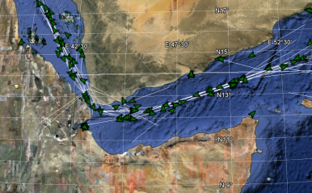
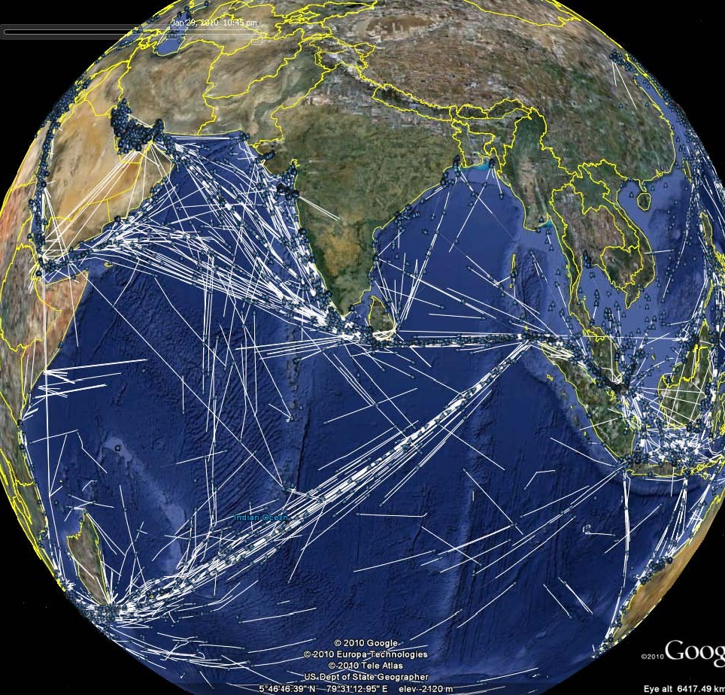
AGENTC Simulation Capability
Simulation Platform
Real-world data sources
GIS-enabled user frontend
Executable behavioral models
long-range shipping
patrolling
piracy
…
geographical data
vessel parameters
behavioral data
based on Google Earth
Scalable simulation engine
supports dynamic data
supports parallel operation of 1000s vessels
Route Planner
Finds shortest sea route
Precomputed navigation graph for acceleration

Slide 66
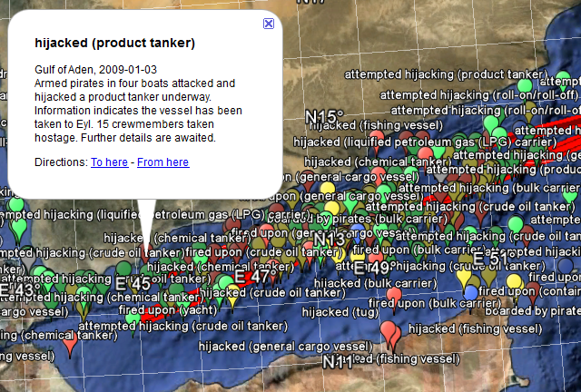
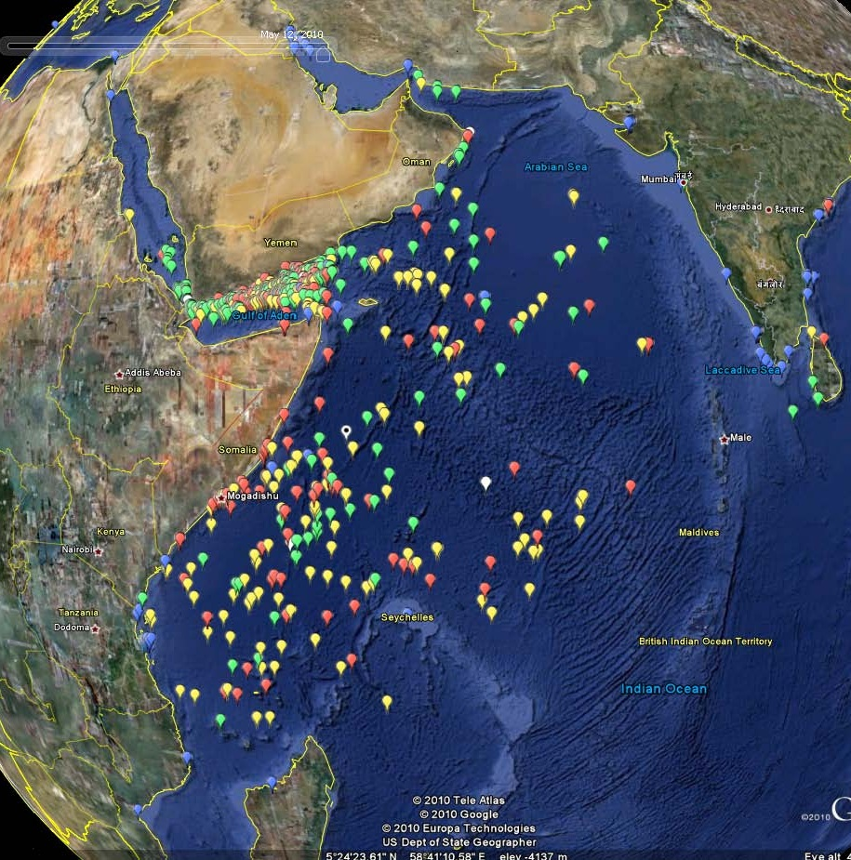
AGENTC Simulation Capability
Simulation Platform
Real-world data sources
GIS-enabled user frontend
Executable behavioral models
long-range shipping
patrolling
piracy
…
geographical data
vessel parameters
behavioral data
based on Google Earth
Scalable simulation engine
supports dynamic data
supports parallel operation of 1000s vessels
Route Planner
Finds shortest sea route
Precomputed navigation graph for acceleration

Slide 67
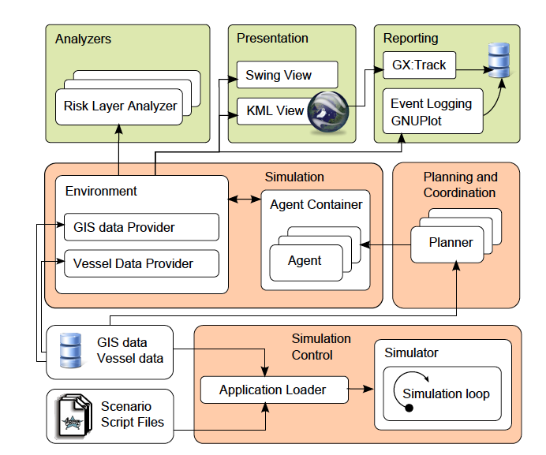
AGENTC Simulation Architecture

Slide 68
COME & SEE AGENTC AAMAS2011 DEMO

Slide 70
MASim Suitable Application Areas
Agents/Actors exhibit intelligent (deliberative) behavior, including learning, adaptation and strategic reasoning
Agent’s behavior has non-smooth/discrete dynamics with thresholds, if-then rules, observation-based and interaction-based triggers etc.
Interactions between agents are complex, nonlinear, discontinuous, or discrete; network-effects apply
Topology of the interactions is heterogeneous and complex
Population is heterogeneous and large scale
Space is crucial and the agents' positions are not fixed
System-level equations are not known, hard to reconstruct, do not exist or computational intractable

Slide 71
AgentPOLIS – Traffic Model
Large-scale multi-agent model of urban mixed transport
Based on activity-rich urban citizen lifecycle model, bottom-up model
Multiple transport modes
individual cars, bikes, mass public transport (metro, trams, buses)
real lines and approximate schedules
Tested with 100k agents but further scale-up possible
In parts funded by IBM, government grant awarded (rejected by IBM)
Will be used for experimenting with Prague metro fare-evaders project
Notes:
SOTA:
trip-based
Activity based

Slide 72
AgentPOLIS – Traffic Model
Traffic modeling: Model traffic demand and distribution to aid infrastructure planning and understand the impact of policy decisions
3 principal approaches: trip-based, activity-based, agent-based.
GOALS:
Study agents strategic behavior with respect to mixed-modal choice of various means of transport and various times of transport in context of their social and individual activities
By means of incentives, design methods for optimization
Car-pooling, request-based bus services, cab sharing, zip-cars, etc.
Also used for studying railway fare enforcement methods
Notes:
Agent based modeling has been chosen in order to be able to model collective behavior and strategic reasoning of the actors

Slide 73
AgentPOLIS – Traffic Model
At home
Large-scale multi-agent model of urban mixed transport
Based on activity-rich urban citizen lifecycle model, bottom-up model
Multiple transport modes
individual cars, bikes, mass public transport (metro, trams, buses)
real lines and approximate schedules
Combination of trip-based and activity-based approach
Tested with 100k agents but further scale-up possible
In parts funded by IBM, government grant awarded (rejected by IBM)
Will be used for experimenting with Prague metro fare-evaders project
Travelling to work
Working
Having Lunch
Working
Shopping
Entertainment
Travelling home

Slide 74
AgentPOLIS – Traffic Model
Large-scale multi-agent model of urban mixed transport
Based on activity-rich urban citizen lifecycle model, bottom-up model
Multiple transport modes
individual cars, bikes, mass public transport (metro, trams, buses)
real lines and approximate schedules
Combination of trip-based and activity-based approach
Tested with 100k agents but further scale-up possible
In parts funded by IBM, government grant awarded (rejected by IBM)
Will be used for experimenting with Prague metro fare-evaders project

Slide 75
AgentPolis Architecture Overview
Google Earth visualization
A-light visualization and reporting
Agents
Geo data processing and management
Lifecycles
Activities
Mental states
Population distribution
Environment
Sensors
Actions
Road networks
Entities and Storages
Networks and Maps
Transportation lines
ALITE
Java Platform
Notes:
TODO: visual hierarchy in lables

Slide 76
AgentPOLIS DEMO

Slide 78
Horizontal Model Integration
Aspects of urban life
Leisure
Economic
Mobility
Economy
Health
Social
Environment
Shopping
Traffic macro simulation
Urban development
Waste management
Traffic mezo simulation
Crime modeling
Car flow microsimulation
Pedestrian microsimulation
Agent-based approach enables horizontal integration
Notes:
Multiple simulations
Agent Decision Points/Process

Slide 79
Conclusion
AGLOBEX Simulation
real-time
non-deterministic
ALITE Simulation
event-driven
deterministic
Intermittent AX Simulation
hybrid architecture
round-based
deterministic
distributed environment
centralized environment
in vitro architecture
centralized environment
classical architecture
state+beharior in entity
state+beharior in entity
separated entity states
centralized simulation
distriuted simulation
parallelized simulation
asynchronous agents
synchronous agents
synchronous agents
hardware in the loop
synchronous environments
time/space heterogenity

Slide 80
Conclusion
AGLOBEX Simulation
real-time
non-deterministic
event-driven
deterministic
Intermittent AX Simulation
hybrid architecture
round-based
deterministic
distributed environment
centralized environment
repeated simulations
centralized environment
classical architecture
state+beharior in entity
state+beharior in entity
separated entity states
centralized simulation
distriuted simulation
parallelized simulation
asynchronous agents
synchronous agents
synchronous agents
hardware in the loop
synchronous environments
time/space heterogenity
ALITE Simulation

